Slide 1
Works
1
Introduction, Material & Methods writing
2
Majority voting of three biomarker prediction model for MSI status detection

Slide 2
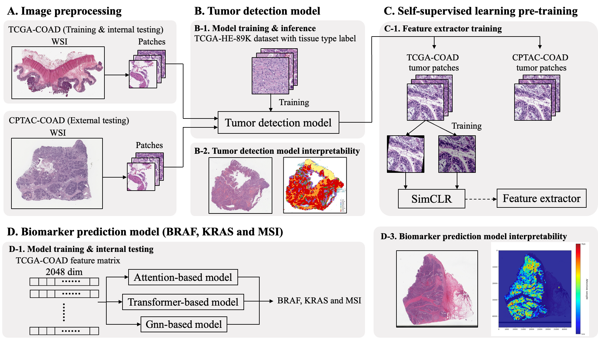

Slide 3
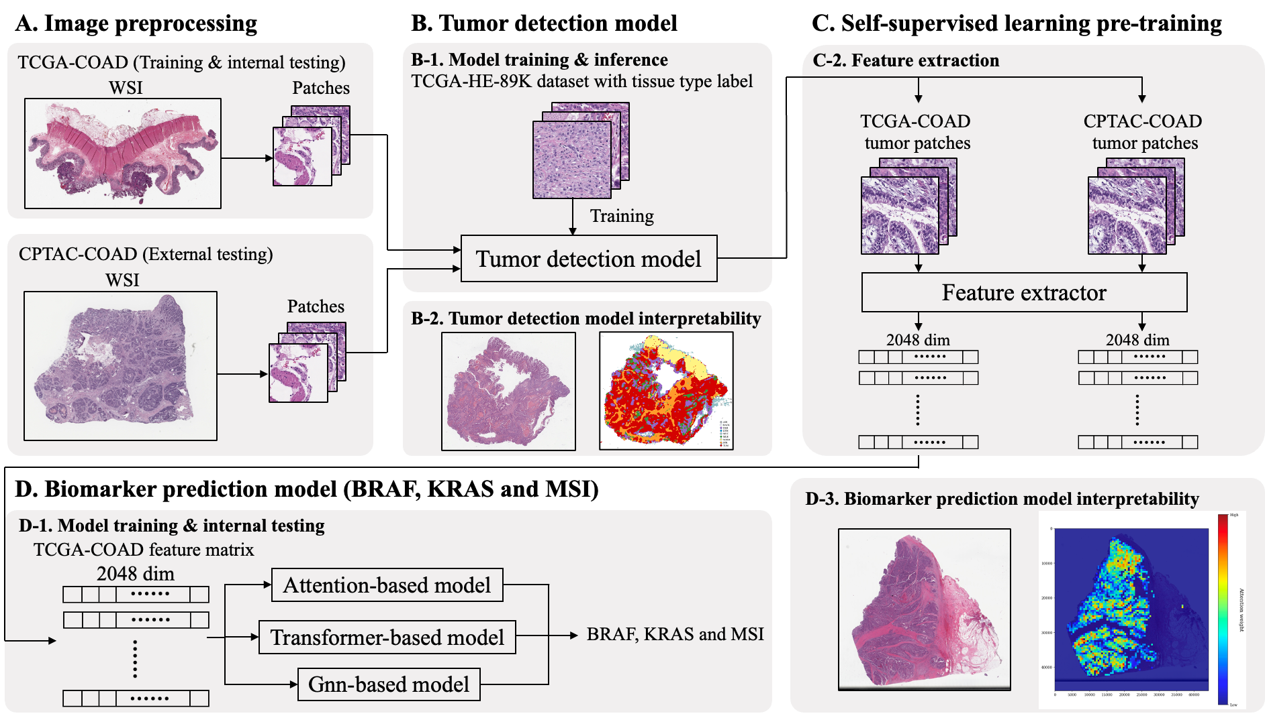

Slide 4
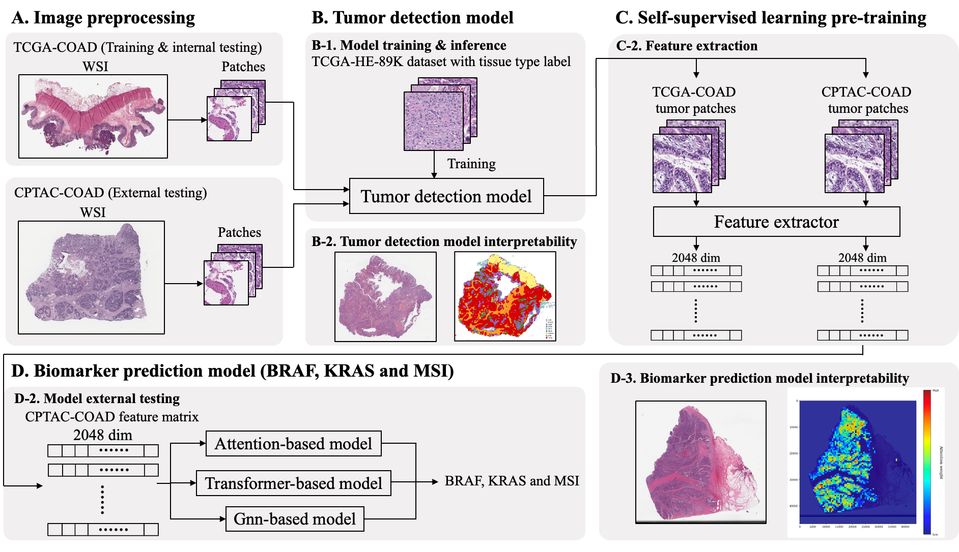

Slide 5
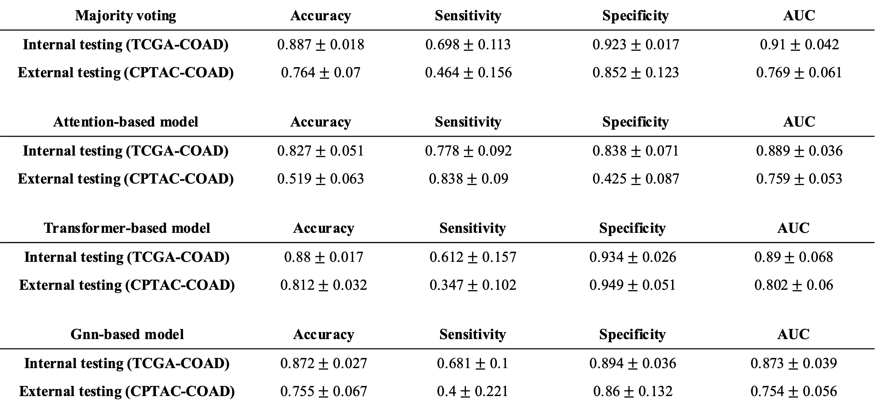
Majority voting (MSI)

Slide 6
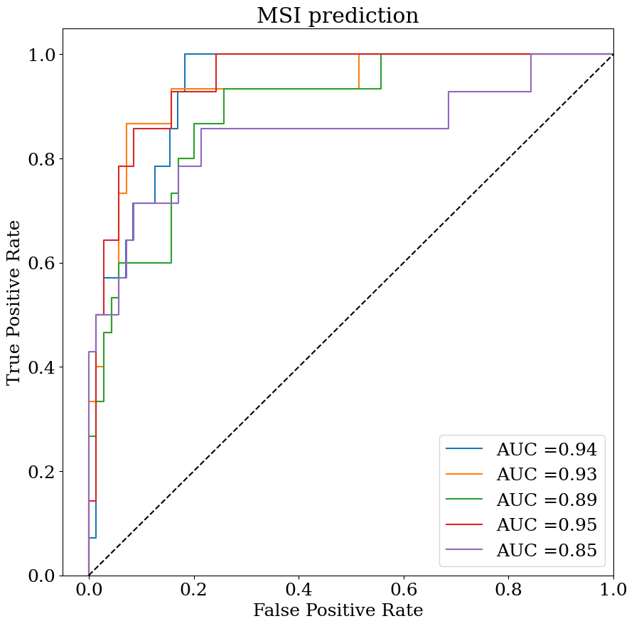
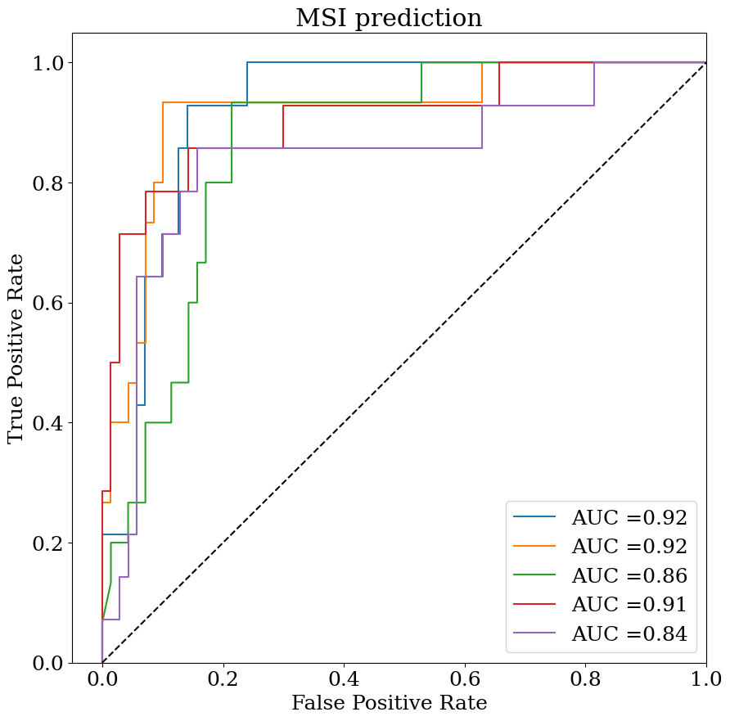
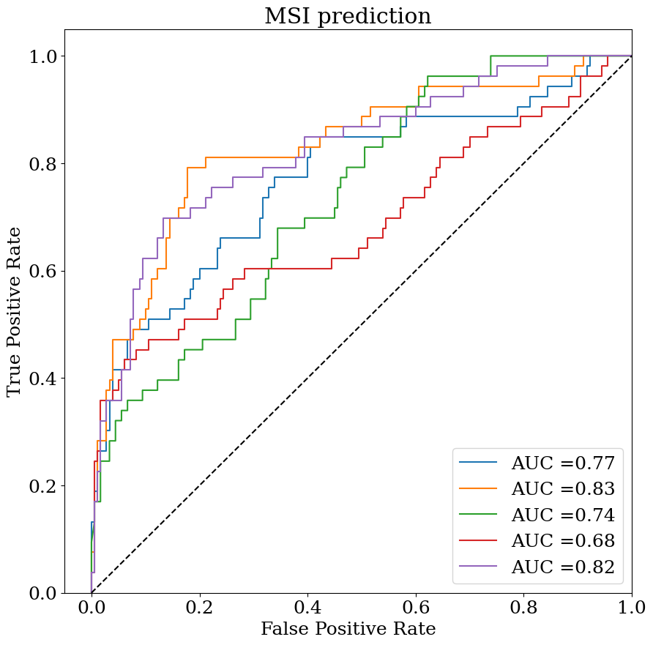
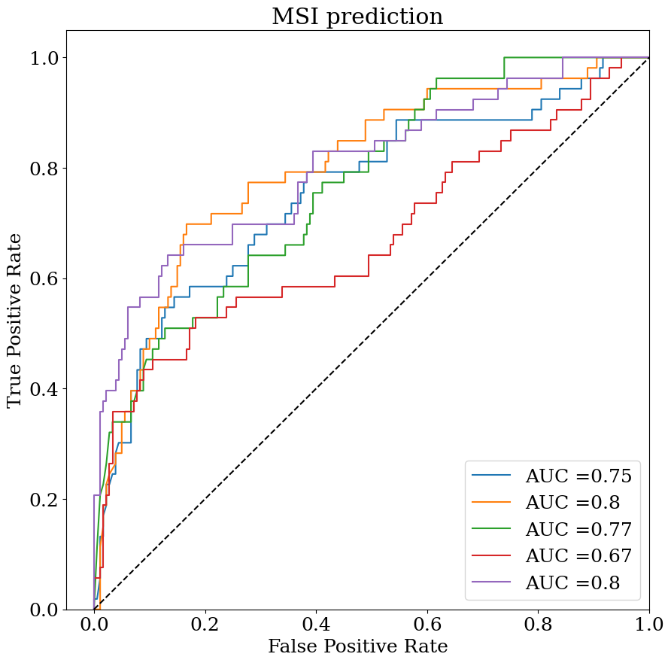
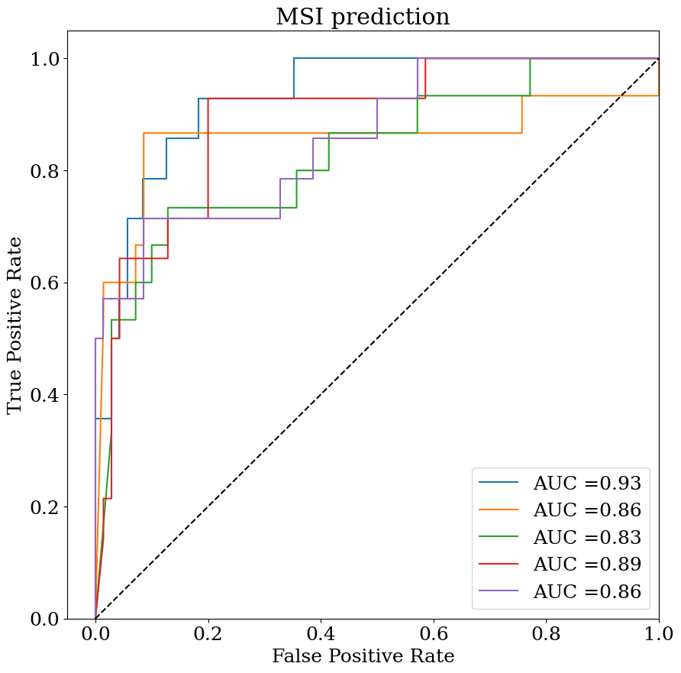
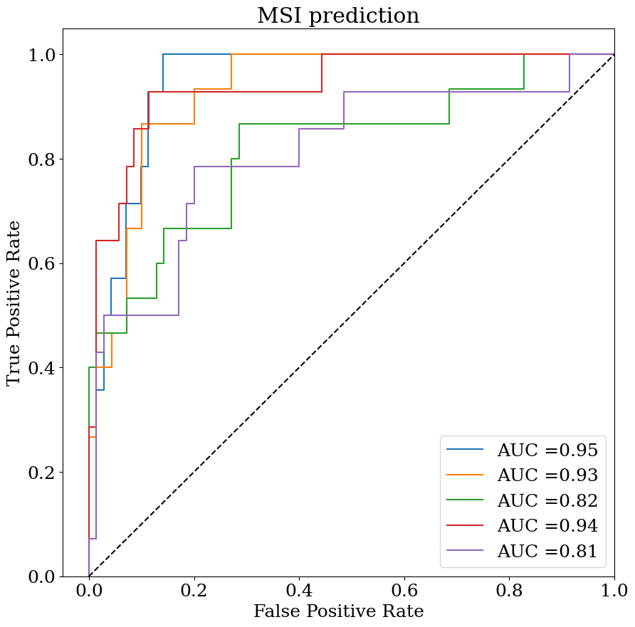
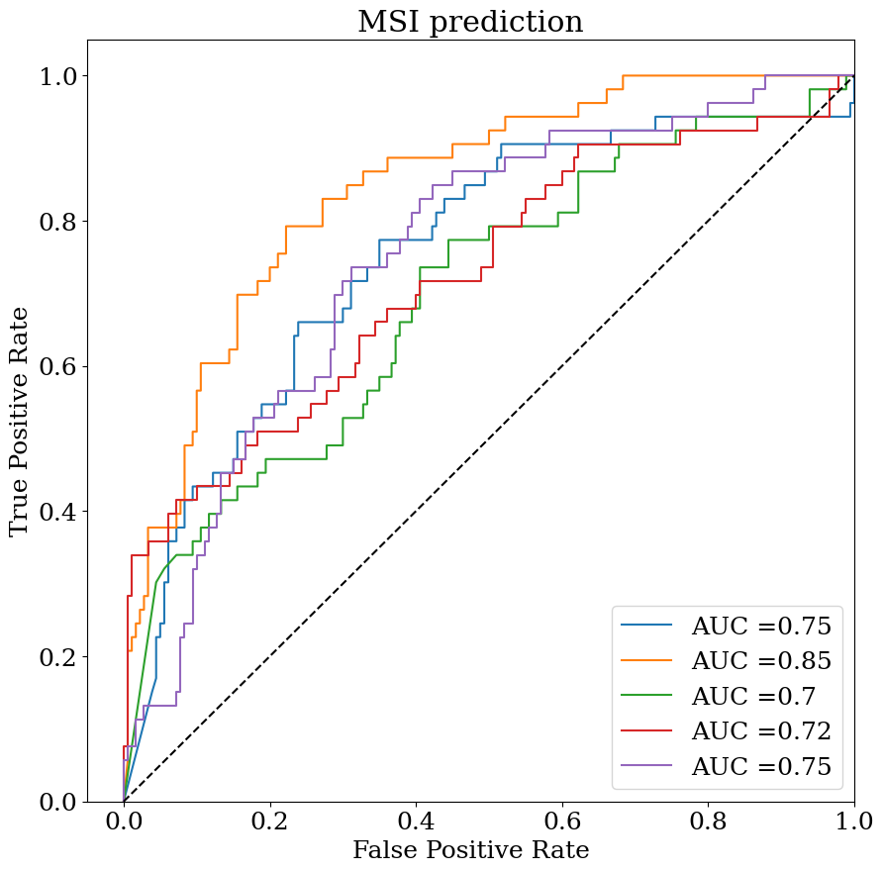
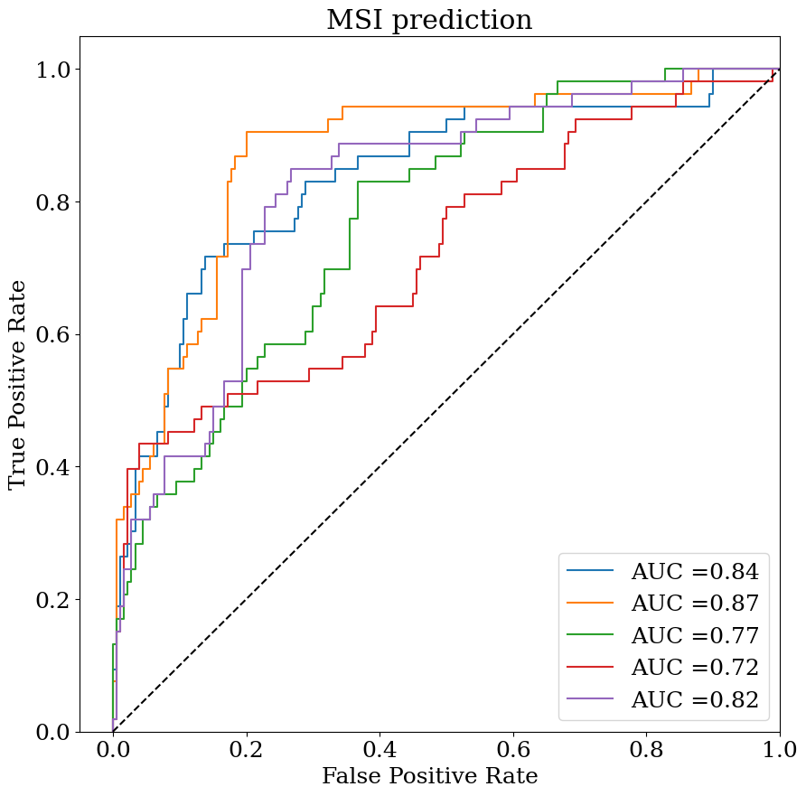
ROC curve (MSI)
Internal testing (TCGA-COAD)
External testing (CPTAC-COAD)
majority voting
attMIL
majority voting
attMIL
gnnMIL
transMIL
gnnMIL
transMIL

Slide 7
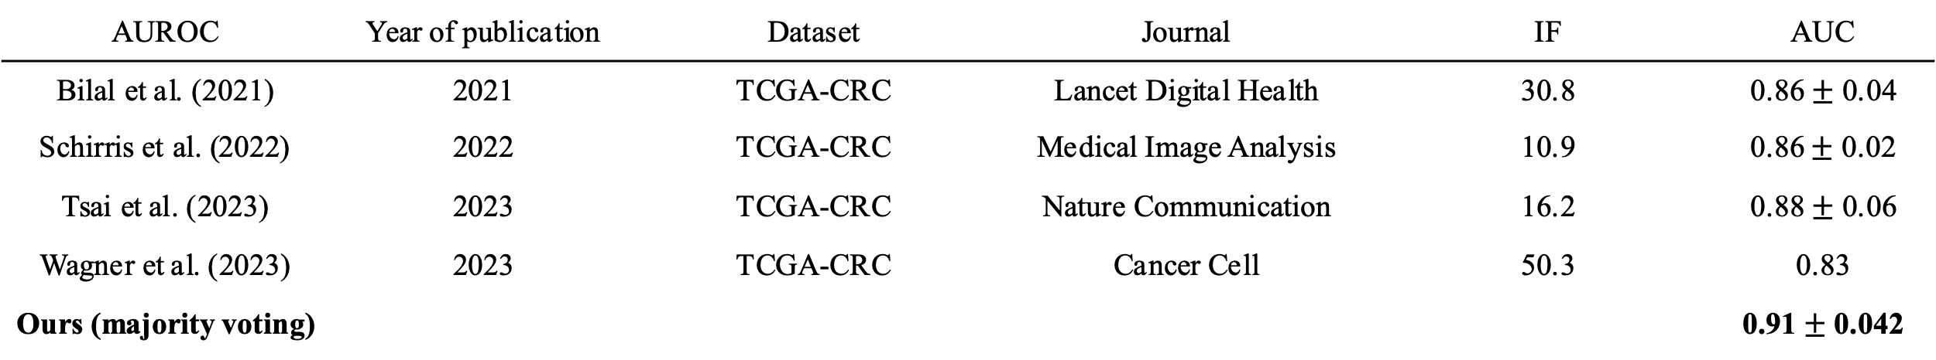
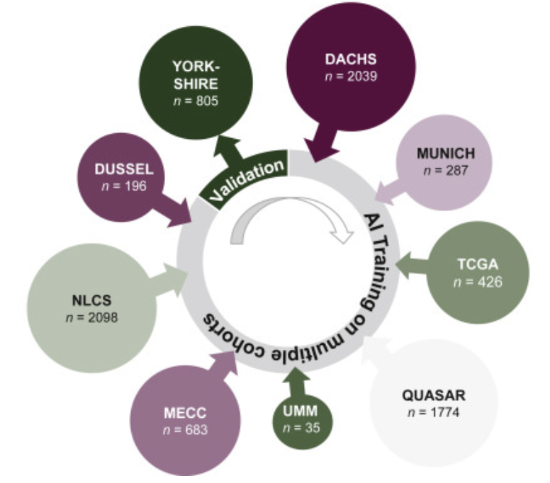
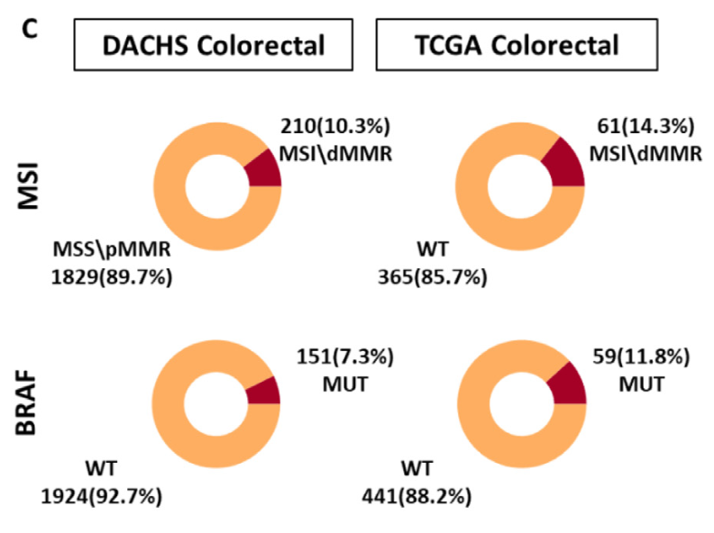
MSI prediction literature comparison
Compare with the literature that publish in last several years, our performance reach the similar result as other research.
Some of the research integrate multiple cohort such as Echle et al. (2022) and Laleh et al. (2022)

Slide 8
Future works
1
Thesis writing
2
Ensemble BRAF and KRAS biomarker prediction model

